Slide 1
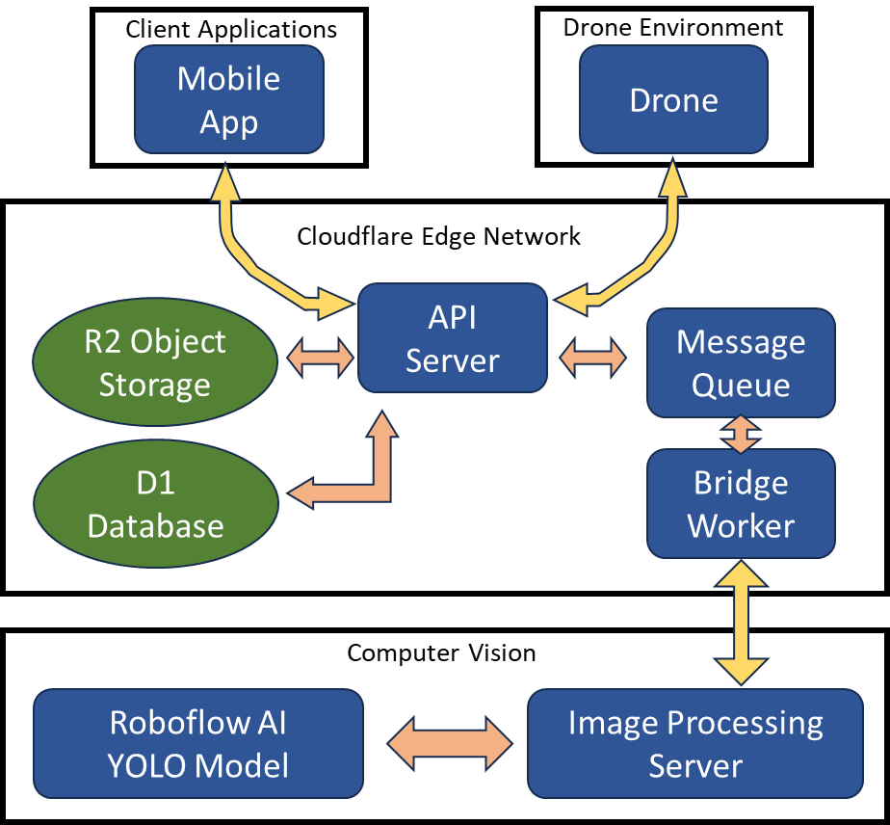
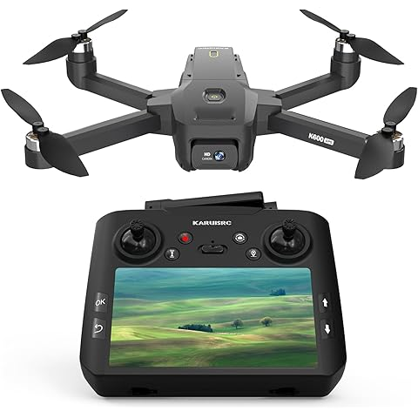
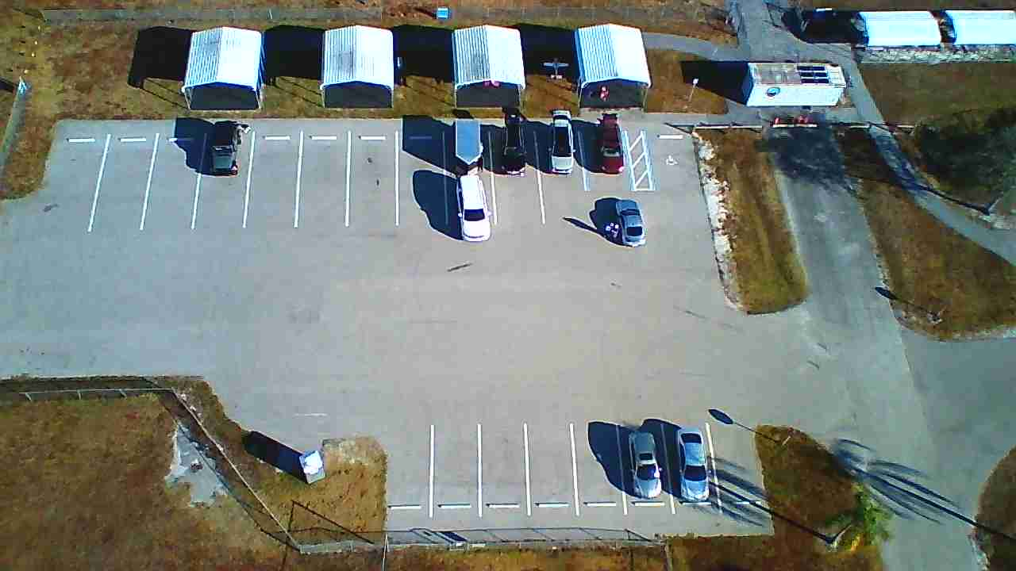
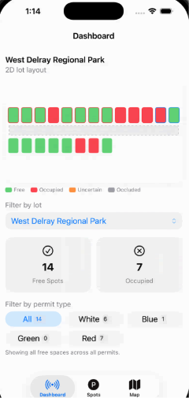
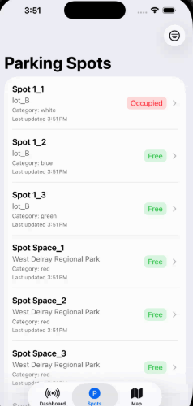
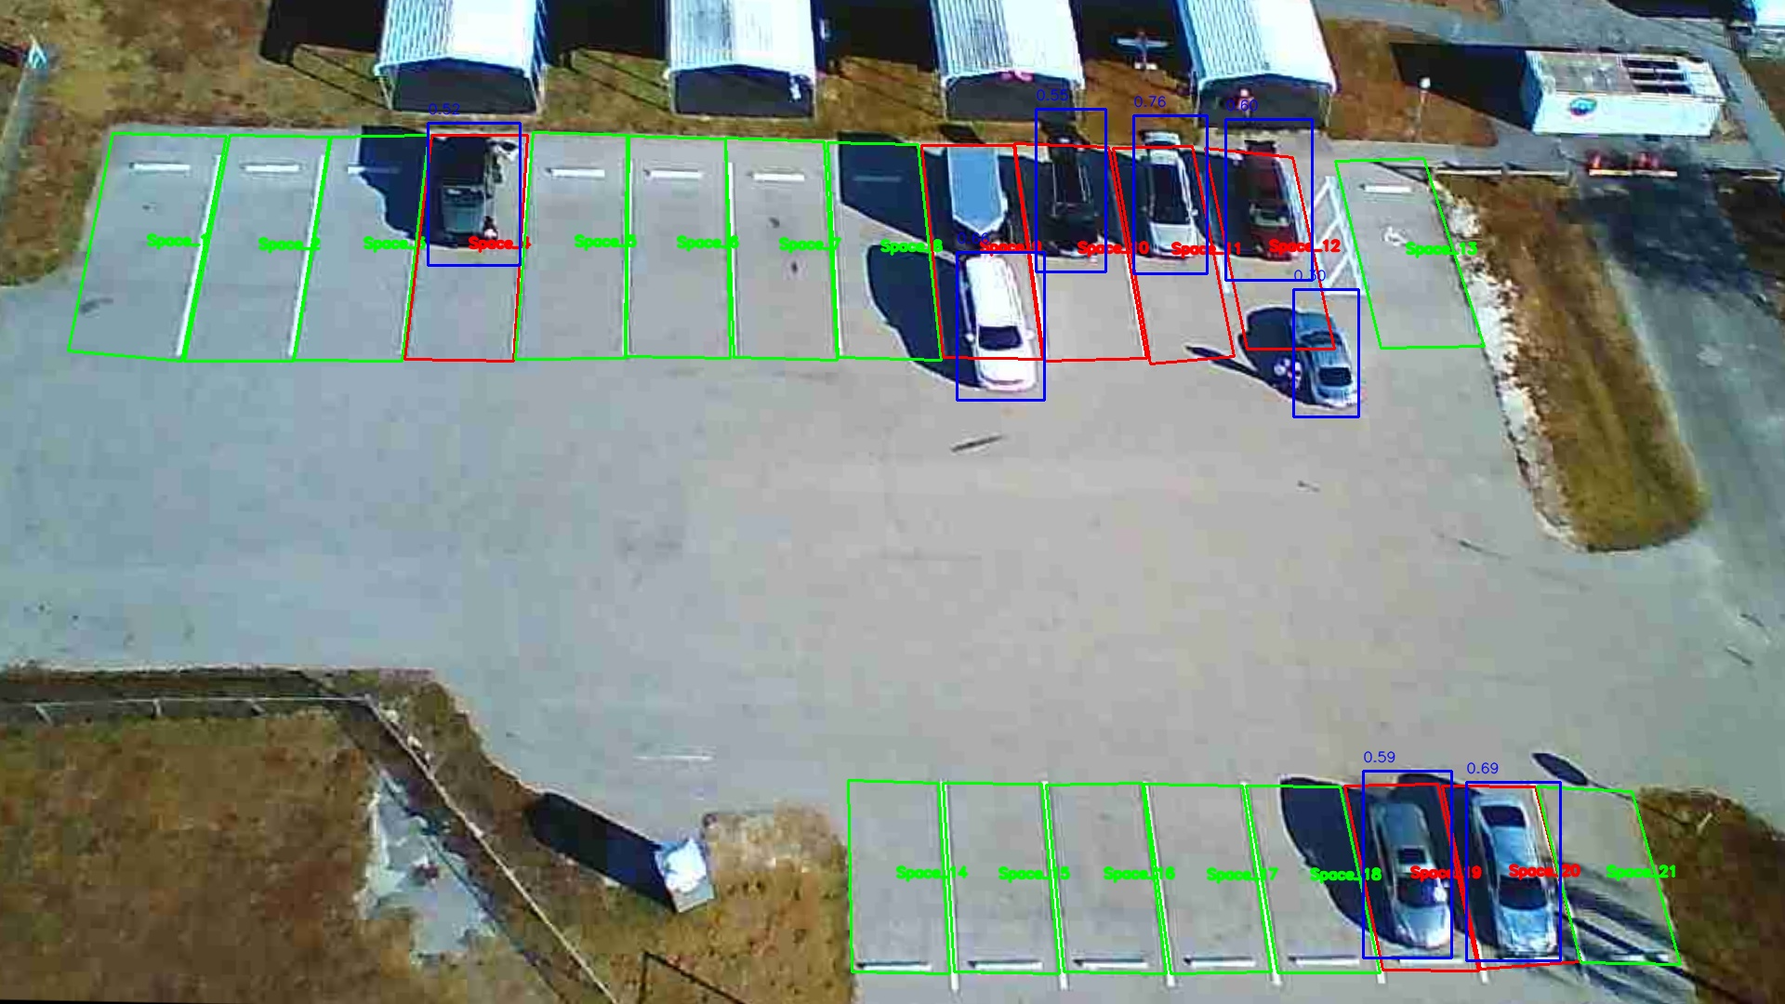
Drone Imagery Based Parking Management System
Team Members
Khalid Abdallah
Gabriel Fusaro
Bryan Gatto
Oliver Si
Lance Van
Faculty Course Facilitator
Dr. Waseem Asghar
Dr. KwangSoo Yang
EGN 4952C
Electrical Engineering & Computer Science
Project Advisor
#7
Sponsored by: Dr. Arslan Munir
Dr. Zhen Ni
Problem Statement
Parking congestion remains a major challenge at Florida Atlantic University’s (FAU) Boca Raton campus, particularly during peak academic hours and special events such as football games. Students, faculty, and staff often spend significant time searching for available parking, which results in:
Increased traffic flow within lots
Wasted fuel and time
Frustration and reduced campus experience
Currently, there is no efficient real-time system to guide drivers to available spaces in open-air lots based on parking category (student, faculty/staff, disabled, visitor).
Results
Our team has successfully developed a prototype that addresses the parking congestion problem.
The navigation program automates the redirection of the drone's position only needing set GPS checkpoints, sends quality JPEG images to the server, and can adapt to unexpected flight conditions by implementing corrective procedures.
The backend ingests drone imagery, aligns the new drone image then preprocesses the image which is subsequently sent to the detection model to determine vehicle occupancy, and updates the database.
The frontend program creates an easy-to-read mobile app with a user interface that shows the user helpful information such as the number of available spots and their locations.
Conclusions & Impact
This project allows for an easy implementation of open-lot occupancy monitoring as it can obtain quality data of any parking lot after retrieving the relevant GPS coordinates without installing permanent equipment on existing infrastructure. The project also makes it easy for drivers to see spaces amidst congestion through the user-friendly mobile app. This ensures that everyone involved, whether driver or facility manager, has a practical, flexible, and affordable way to manage traffic better. This system is scalable so that it may be implemented on any and multiple open-air lots.

